Slide 1
SOFTWARE Architecture & DESIGN

Slide 2
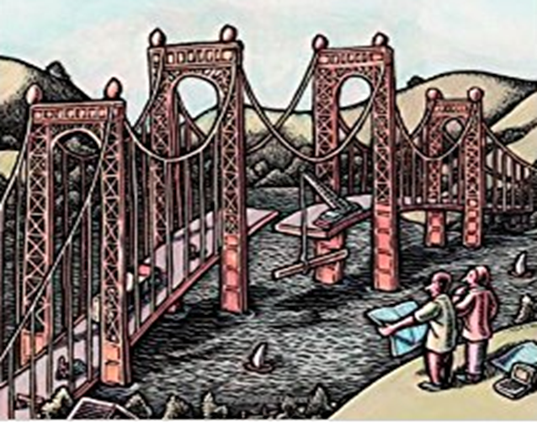
Generic Design Methods
Architectural Views & Styles

Slide 3
Recap – Discussions on Architectural Approach or Model
&
Decomposition

Slide 4
Design Methods
Detailed Design Methods support us in decomposing the components representing the system requirement into components/subcomponents well
This could be structured which is development of modules and the synthesis of these modules in a so called "module hierarchy“ using some kind of charts, module specifications and a data dictionary eg. DFDs
or
could be using some object oriented approaches like Booch or Fusion etc

Slide 5
Design Method 1: Data Flow Design
Yourdon and Constantine (early 70s)
It’s a two-step process:
Structured Analysis (SA), resulting in a logical design, drawn as a set of data flow diagrams
Structured Design (SD) transforming the logical design into a program structure drawn as a set of structure charts

Slide 6
Design Method 1: Data FLOW DIAGRAMS
We typically have the following components in the DFD
External Entity
Source and Destination of a transaction.
These are located outside the domain considered in the DFD.
Depicted as Squares in the diagram
Processes
Transforms the data
Depicted as circles
Data Stores
These lie between processes and are places where data structures reside
Depicted between two parallel lines
Data Flows
Paths where data structures travel between processes and entities and data stores
Depicted as an Arrow

Slide 7
Design Method 1: Top-level DFD: context diagram
Data Flows
Paths where data structures travel between processes and entities and data stores
Depicted as an Arrow
If we can consider an example of trying to build a system for Book lending and managing for a Library
Processes
Transforms the data
Depicted as circles
direction
request
management
client
report
ack’ment
library
system
External Entity
Source and Destination of a transaction.
These are located outside the domain considered in the DFD.
Depicted as Squares in the diagram
external entities
processes
data flows
data stores

Slide 8
Design Method 1: Top-level DFD: context diagram
direction
request
management
client
report
ack’ment
library
system
external entities
processes
data flows
data stores

Slide 9
Design Method 1 :Data flow diagram – First Level Decomposition (Book Lending Automation Example)
client
management
request
Library System
report
direction
Prelim.
proc
log data
Management report
Return request
acknowledgement
Borrow request
log data
Borrow
title
Return title
log file
title
title
catalog adm.
external entities
processes
data flows
data stores

Slide 10
Design Method 1: Second-level decomposition for “preliminary processing”
data base
log file
check
client
data
request
client info
log data
OK
process
request
not OK
borrow
return
request
request

Slide 11
Design Method 1: Example minispec
Once the process in DFDs become sufficiently straight forward and does not warrant further decomposition, then these processes are described as “minispecs” as below.
This communicates the algorithm for the relevant parties
Identification: Process request for a Book
Description:
Enter type of request
1.1 If invalid, issue warning and repeat step 1
1.2 If step 1 repeated 5 times, terminate transaction
Enter book identification
2.1 If invalid, issue warning and repeat step 2
2.2 If step 2 repeated 5 times, terminate transaction
Log client identification, request type and book identification
...

Slide 12
Design Method 1: Data dictionary entries
The contents of the DFDs after we are at a logical decomposed state are recorded in a data dictionary. It’s a precise description of the structure of data
borrow-request = client-id + book-id
return-request = client-id + book-id
log-data = client-id + [borrow | return] + book-id
book-id = author-name + title + (isbn) + [proc | series | other]
Conventions:
[ ]: include one of the enclosed options
|: separates options
+: AND
(): enclosed items are optional

Slide 13
Design Method 1: From data flow diagrams to structure charts
Structured Analysis (SA) resulted in :
Logical model, consisting of a set of DFD’s Augmented by minispecs & data dictionary, etc.
Structured Design :
DFD’s are transitioned to hierarchical structure charts
heuristics for this transition are based on notions of coupling and cohesion
major heuristic concerns choice for top-level structure chart, most often: transform-centered

Slide 14
Design Method 1:Transform-centered design
Input Transform Output
DFD
A
B
D
E
F
G
C
H
K
Do job
B
D
E
Structure Chart
F
A
C
G
H
K
Trace the input through the data flow diagram until it can no longer be considered input. Same from output ..the bubble in between is transform.
Process in DFD becomes components of structure chart .. Data flow becomes -Component invocations
Notes:
Trace the input through the data flow diagram until it can no longer be considered input. Same from output ..the bubble in between is transform.
Process in DFD becomes components of structure chart .. Data flow becomes -Component invocations
Arrows indicate component invocations .. Arrow in data flow .. Opposite to arrow in Component invocation .. A dummy node could also be depicted

Slide 15
Design Method 2: Object Oriented Booch’s method
The Booch method is a method for object-oriented software development
Authored by Grady Booch when he was working for Rational Software (acquired by IBM) published in 1992/94
It is composed of
Object modelling language (is a standardized set of symbols used to model a software system) currently UML is used for this
An iterative object-oriented development process
A set of recommended practices
Its made up of
Macro Process
Conceptualization : establish core requirements
Analysis : develop a model of the desired behaviour
Design : create an architecture
Evolution: for the implementation
Maintenance : for evolution after the delivery
Micro Process
Identification of classes and objects
Identification of their semantics
Identification of their relationships
Specification of their interfaces and implementation
Notes:
Specification of their interfaces and implementation
It has a good way of representation of the system as a model. It also has a poor process model

Slide 16
Introduction to Architectural Views, Styles and Patterns
These Architecture and Design Approaches discussed typically would need to be used by other stakeholders with different perspectives and structured towards solutions.
Architectural View
Views represent ways of describing the Software Architecture, enabling the system to be viewed by different stake holders in perspectives of their interest.
Architectural Styles
Demonstrates how the subsystems or elements are organized or structured
It’s a way of organizing code
Architectural/Design Pattern
Is a known or a proven solution to the architectural/Design problem of structuring and functioning of the subsystems which has been used earlier and is know to work for the problem scenario
E.g. UI View, Process View
E.g. Pipe & filters, Client-Server, Peer-to-Peer etc.
E.g. MVC separating UI from the rest

Slide 17
Combined View of Architectural Styles, Patterns and Design Patterns
deep
some combine
these into “styles”
Architectural
patterns
Knowledge level of the problem domain
Architectural
Styles
Design
patterns
mostly for OO detail design & programming
shallow
programming
level
software design
component
level
Software System
level
Where are these applicable

Slide 18
Architectural Views

Slide 19
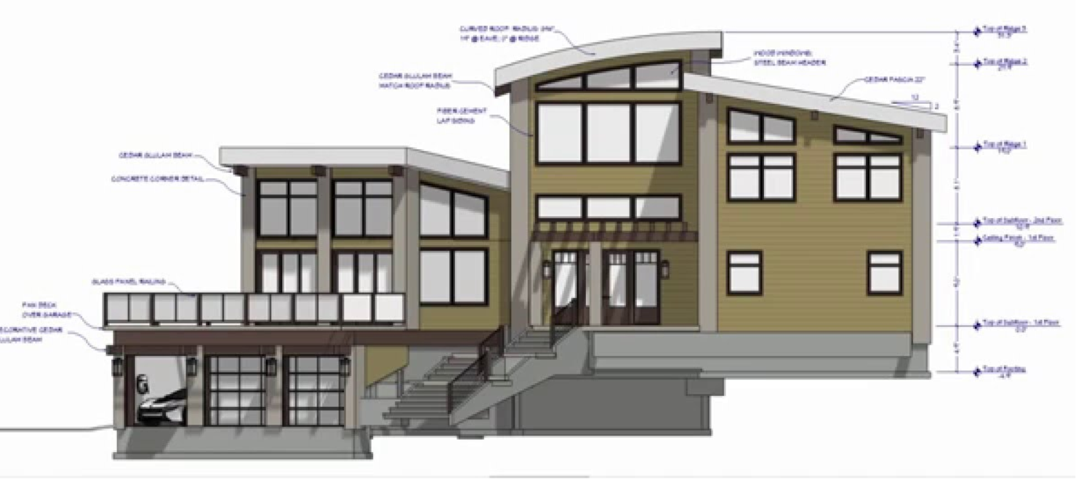
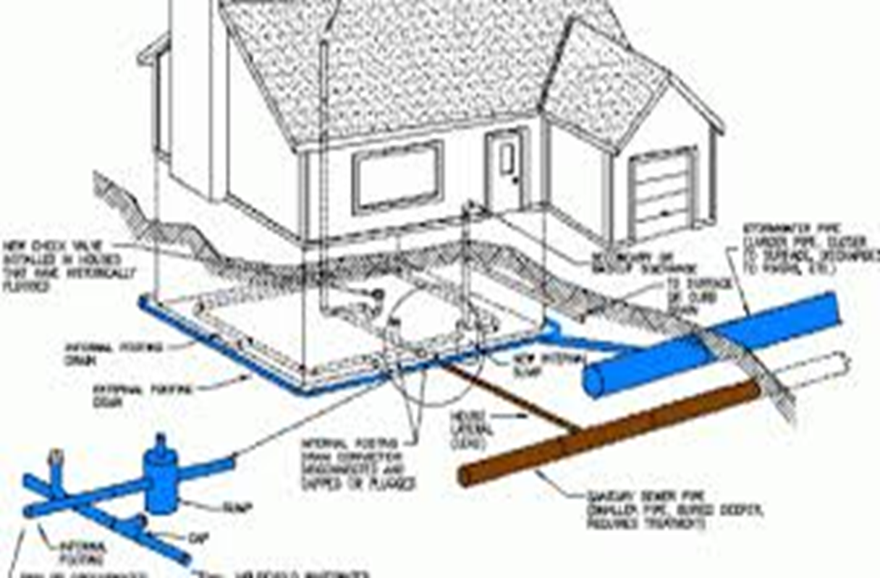
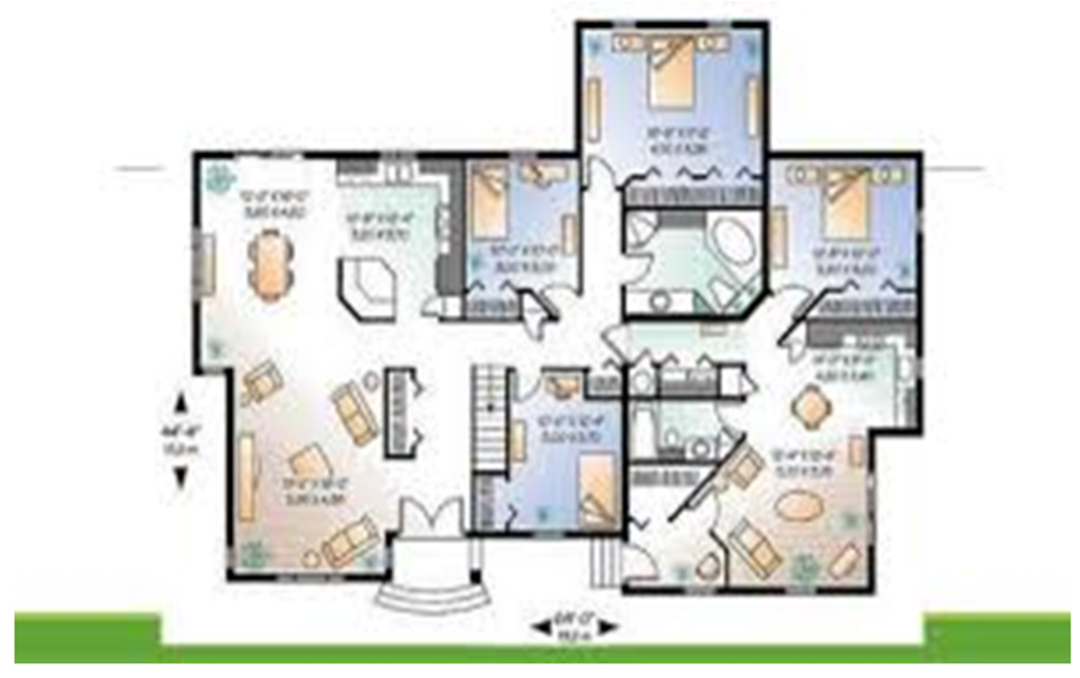
Architectural Views
Example Architectural views of a House
Plumbing View
Elevation
Plan

Slide 20
Architectural Views
There are 4 ways architectural elements can be viewed
As a Structure of Modules (or Module View point)
Modules are units of (code) Implementation with some functional responsibility
Structure the system as a set of code units (modules)
An Architect enumerates what the units of software will have to do and assigns each item to a module
The larger modules may be decomposed to sub-modules of the acceptable fine level by ensuring that likely changes fall within the purview of at most a few small modules.
It is often used as the basis for the development project's organization and deliverables like documentation.
There is less emphasis on how the resulting software manifests itself at runtime

Slide 21
Architectural Views
As a component-and connector structure (or View point)
Dynamic View of considering the system in execution or runtime
E.g. Processes view which would include a set of processes connected by synchronization links
Component or Processing Element is a software which converts inputs to outputs. It could do a computation or act as a server with state and operations or something which governs a sequence of events. E.g. filter or a controller
Data Element information needed for processing or information to be processed e.g. memory with data like a DB
Connecting Element is the glue between the components and the Data element like procedure calls, RPCs.

Slide 22
Architectural Views
As an allocation structure (or View point) includes the
Deployment structure which shows how software is assigned to the hardware elements and which communication paths are used. Relations are "allocated-to“, showing on which physical units the software elements reside, and "migrates-to" if the allocation is dynamic. This view allows an engineer to reason about performance, data integrity, availability, and security. It is of particular interest in distributed or parallel systems
Implementation structure which indicates how software is mapped onto file structures in the system's development, integration, or configuration control environments
Work Assignment structure which shows who is doing what and helps to determine which knowledge is needed where. E.g. Functional commonality to a single team.

Slide 23
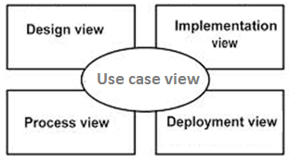
Architectural Views
Or Logical View
Or Development View
Krutchens (4+1 View) or model
Use case view (exposing the requirements of the system or the scenarios)
Design view (exposes vocabulary of the problem space and the solution space) Class Diagrams, Sequence diagrams etc.
Process view encompasses the dynamic aspects or the runtime behavior of the system. Threads and processes that form the systems. Addresses performance, Concurrency etc.
Implementation view (addresses the realization of the system. UML diagrams like package diagrams are used)
Deployment view (focuses on system engineering issues)
Or Physical View

